Slide 1
Who is the best Formula One driver?
Erik-Jan van Kesteren & Tom Bergkamp

Slide 2
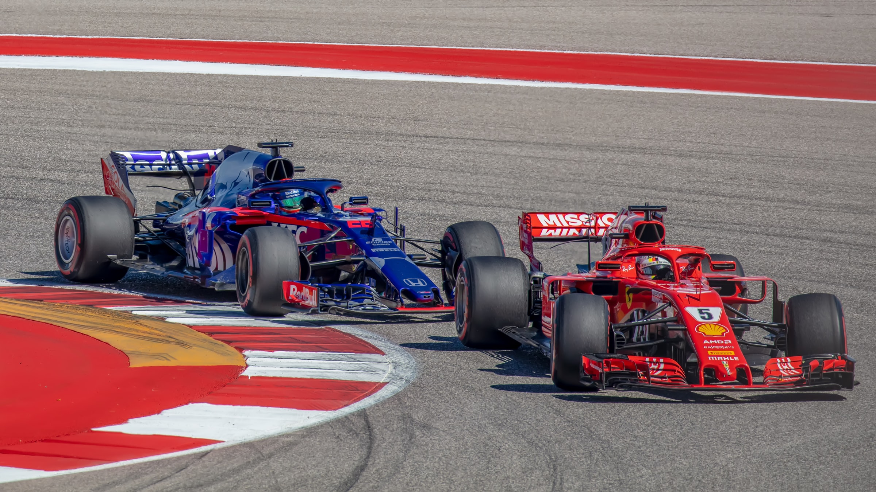
Photo by Bill Stephan on Unsplash
Notes:
https://unsplash.com/photos/fXW7D5V6w68
2

Slide 3
“Why would you like that?”

Slide 4
“Such a stupid sport!”

Slide 5
“It’s all about the cars anyway!”

Slide 6
Is it?

Slide 7
Who is the best Formula One driver?
A Bayesian multilevel Beta regression model
Erik-Jan van Kesteren & Tom Bergkamp

Slide 8
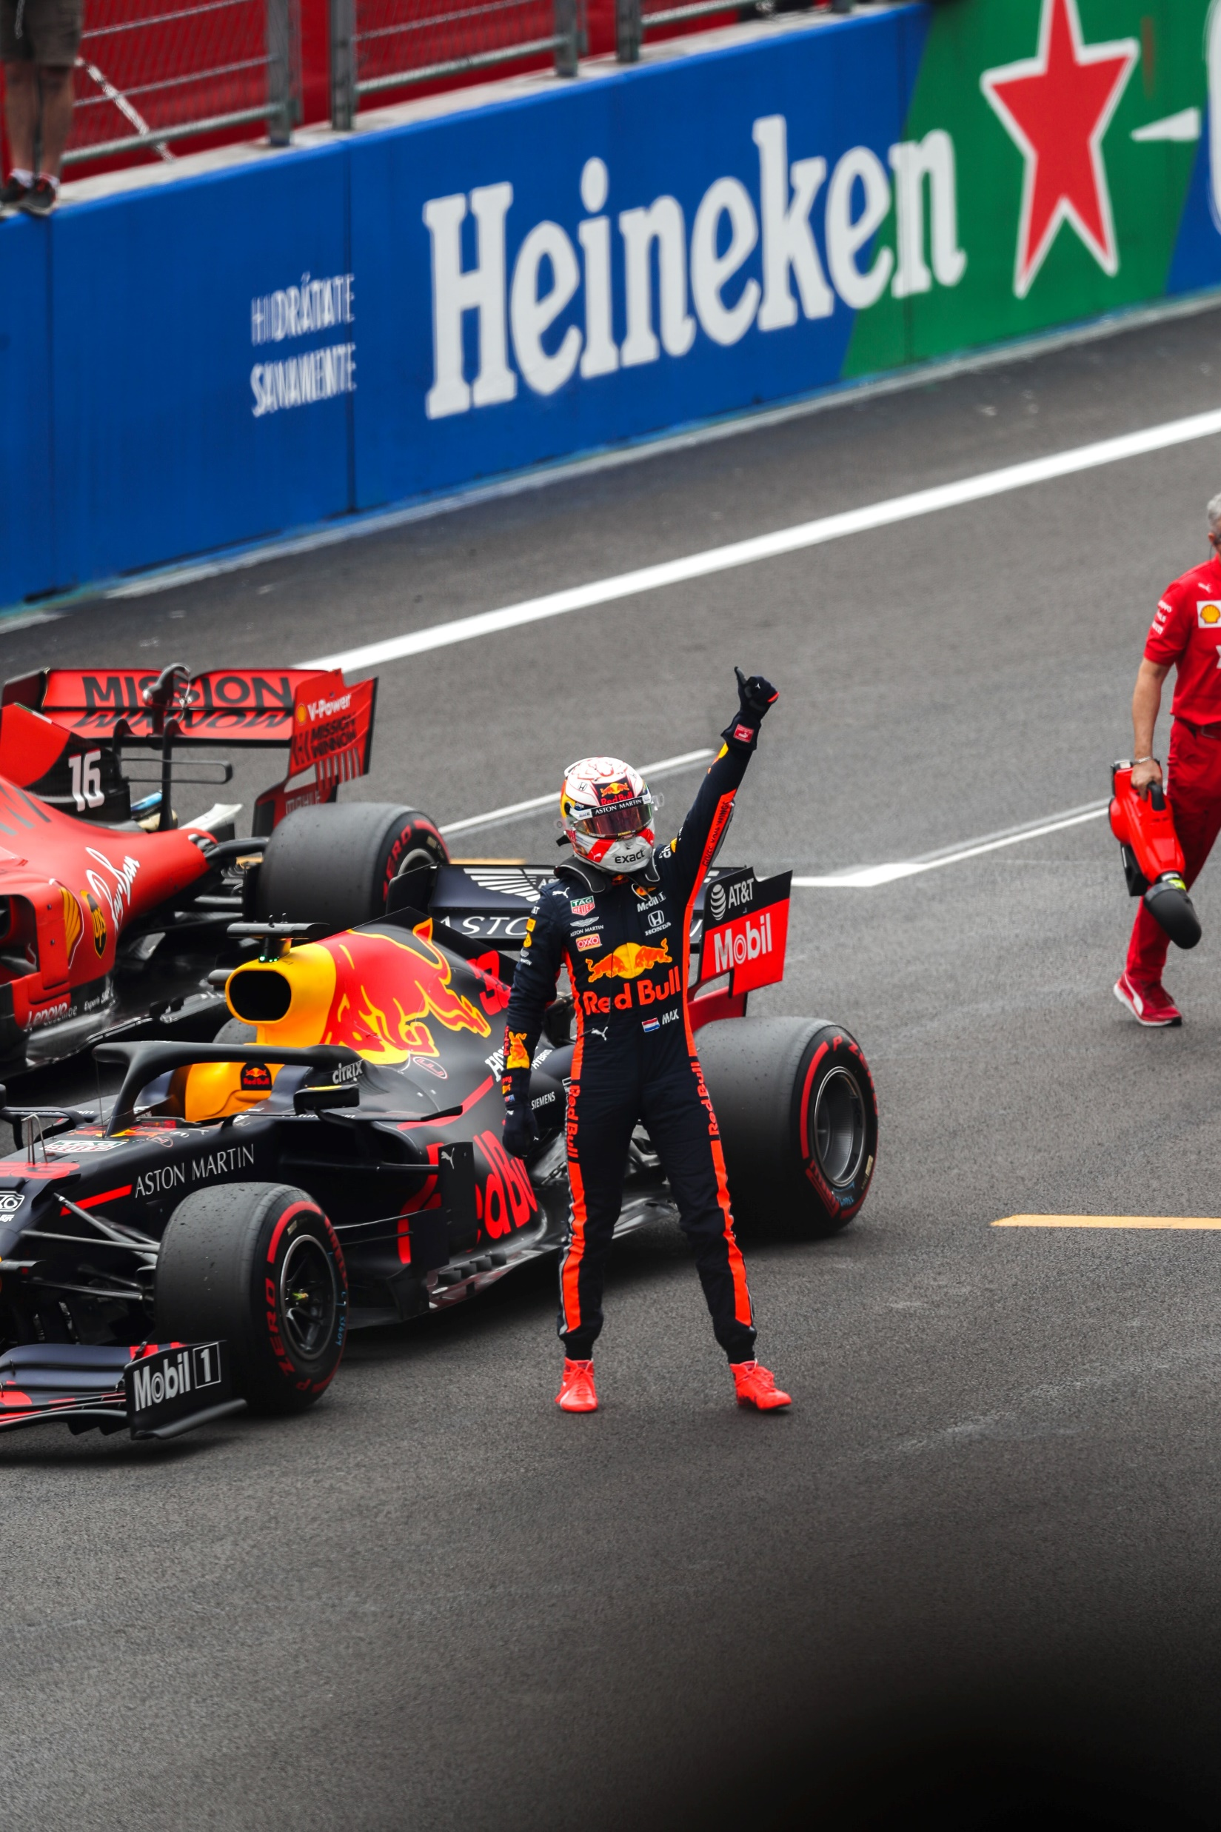
Very boring outline
Data collection & pre-processing
Measuring performance
Model development
Model estimation & checks
Inferences & conclusions
Photo by José Pablo Domínguez on Unsplash
Notes:
https://unsplash.com/photos/a14l5pHzf90

Slide 9
The data

Slide 10
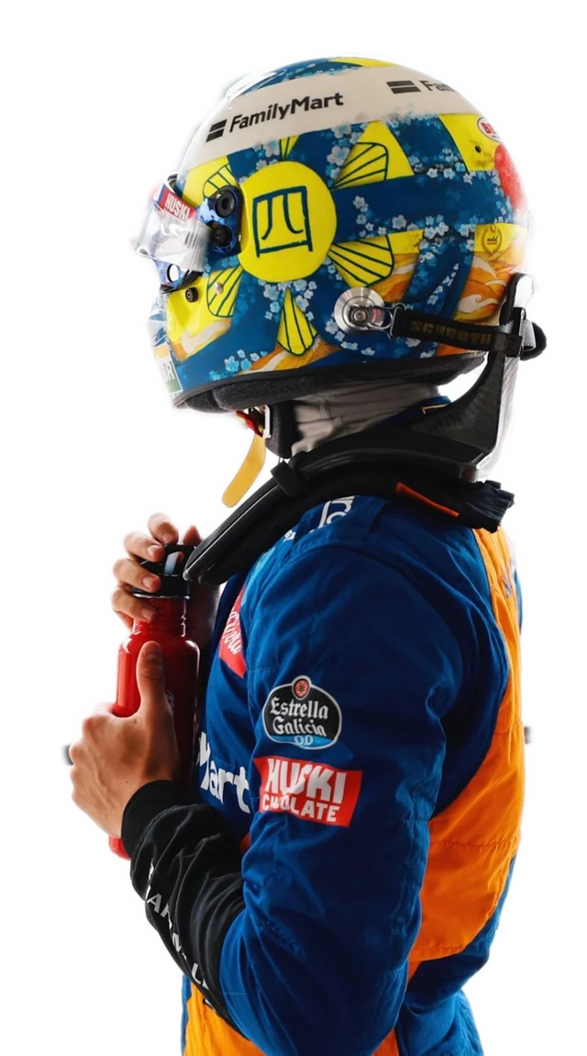
Formula One 101
The constructors
There are around 10 teams
Two cars each, new cars each year
Teams change owners & name
New teams enter sometimes
Ferrari, Mercedes & Red Bull are rich
The hybrid era of F1
Rules & regulations change
Most notably: engine regulations
2014-2021 is known as the “hybrid era”
Every year/season has around 21 races
The drivers
Drivers usually enter F1 with a “junior” team
They change team: everyone wants to go to the best teams
Drivers are compared to their teammates a lot
Being a good driver means:
Driving really fast
Managing tires
Being consistent
Overtaking others
Notes:
https://www.reddit.com/r/formula1/comments/dgu0gr/lando_wearing_his_handpainted_helmet_at_suzuka/?utm_source=share&utm_medium=web2x&context=3
10

Slide 11
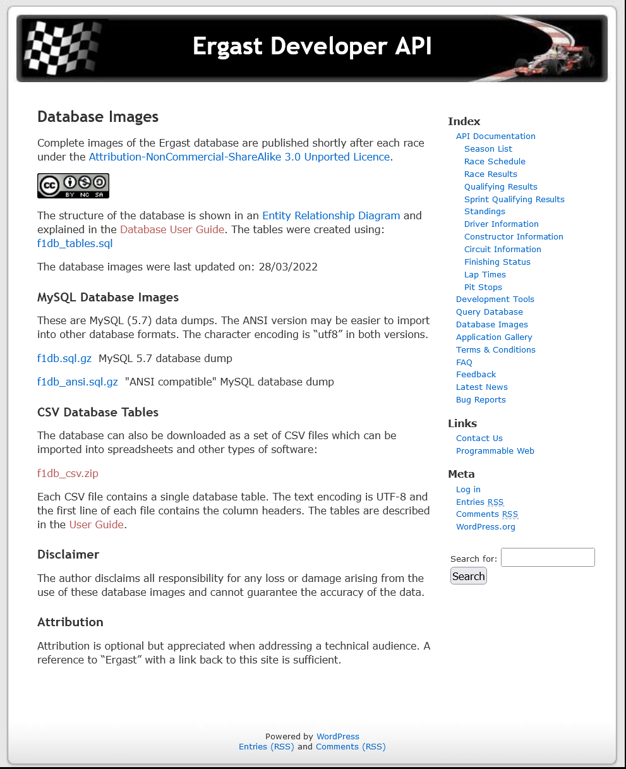
The data
We want data about all race results of the hybrid era
It exists! Ergast
An API
A full data dump
Updated after every race

Slide 12
The data: preprocessing
Download Ergast data
Join race results with driver properties & circuit properties
Add information scraped from Wikipedia:
Weather (wet or dry race)
Circuit type (street circuit / permanent circuit)
Some cleanup & variable type conversion

Slide 13
The data: tidy!
# A tibble: 3,267 x 9
driver constructor year round circuit position weather_type circuit_type status
<fct> <fct> <int> <int> <chr> <int> <fct> <fct> <fct>
1 rosberg mercedes 2014 1 albert_park 1 dry street Finished
2 kevin_magnussen mclaren 2014 1 albert_park 2 dry street Finished
3 button mclaren 2014 1 albert_park 3 dry street Finished
4 alonso ferrari 2014 1 albert_park 4 dry street Finished
5 bottas williams 2014 1 albert_park 5 dry street Finished
6 hulkenberg force_india 2014 1 albert_park 6 dry street Finished
7 raikkonen ferrari 2014 1 albert_park 7 dry street Finished
8 vergne toro_rosso 2014 1 albert_park 8 dry street Finished
9 kvyat toro_rosso 2014 1 albert_park 9 dry street Finished
10 perez force_india 2014 1 albert_park 10 dry street Finished
# ... with 3,257 more rows

Slide 14
Measuring “performance”

Slide 15
The best race result is finishing first The worst race result is finishing last
Sometimes, a contestant does not finish at all!?

Slide 16
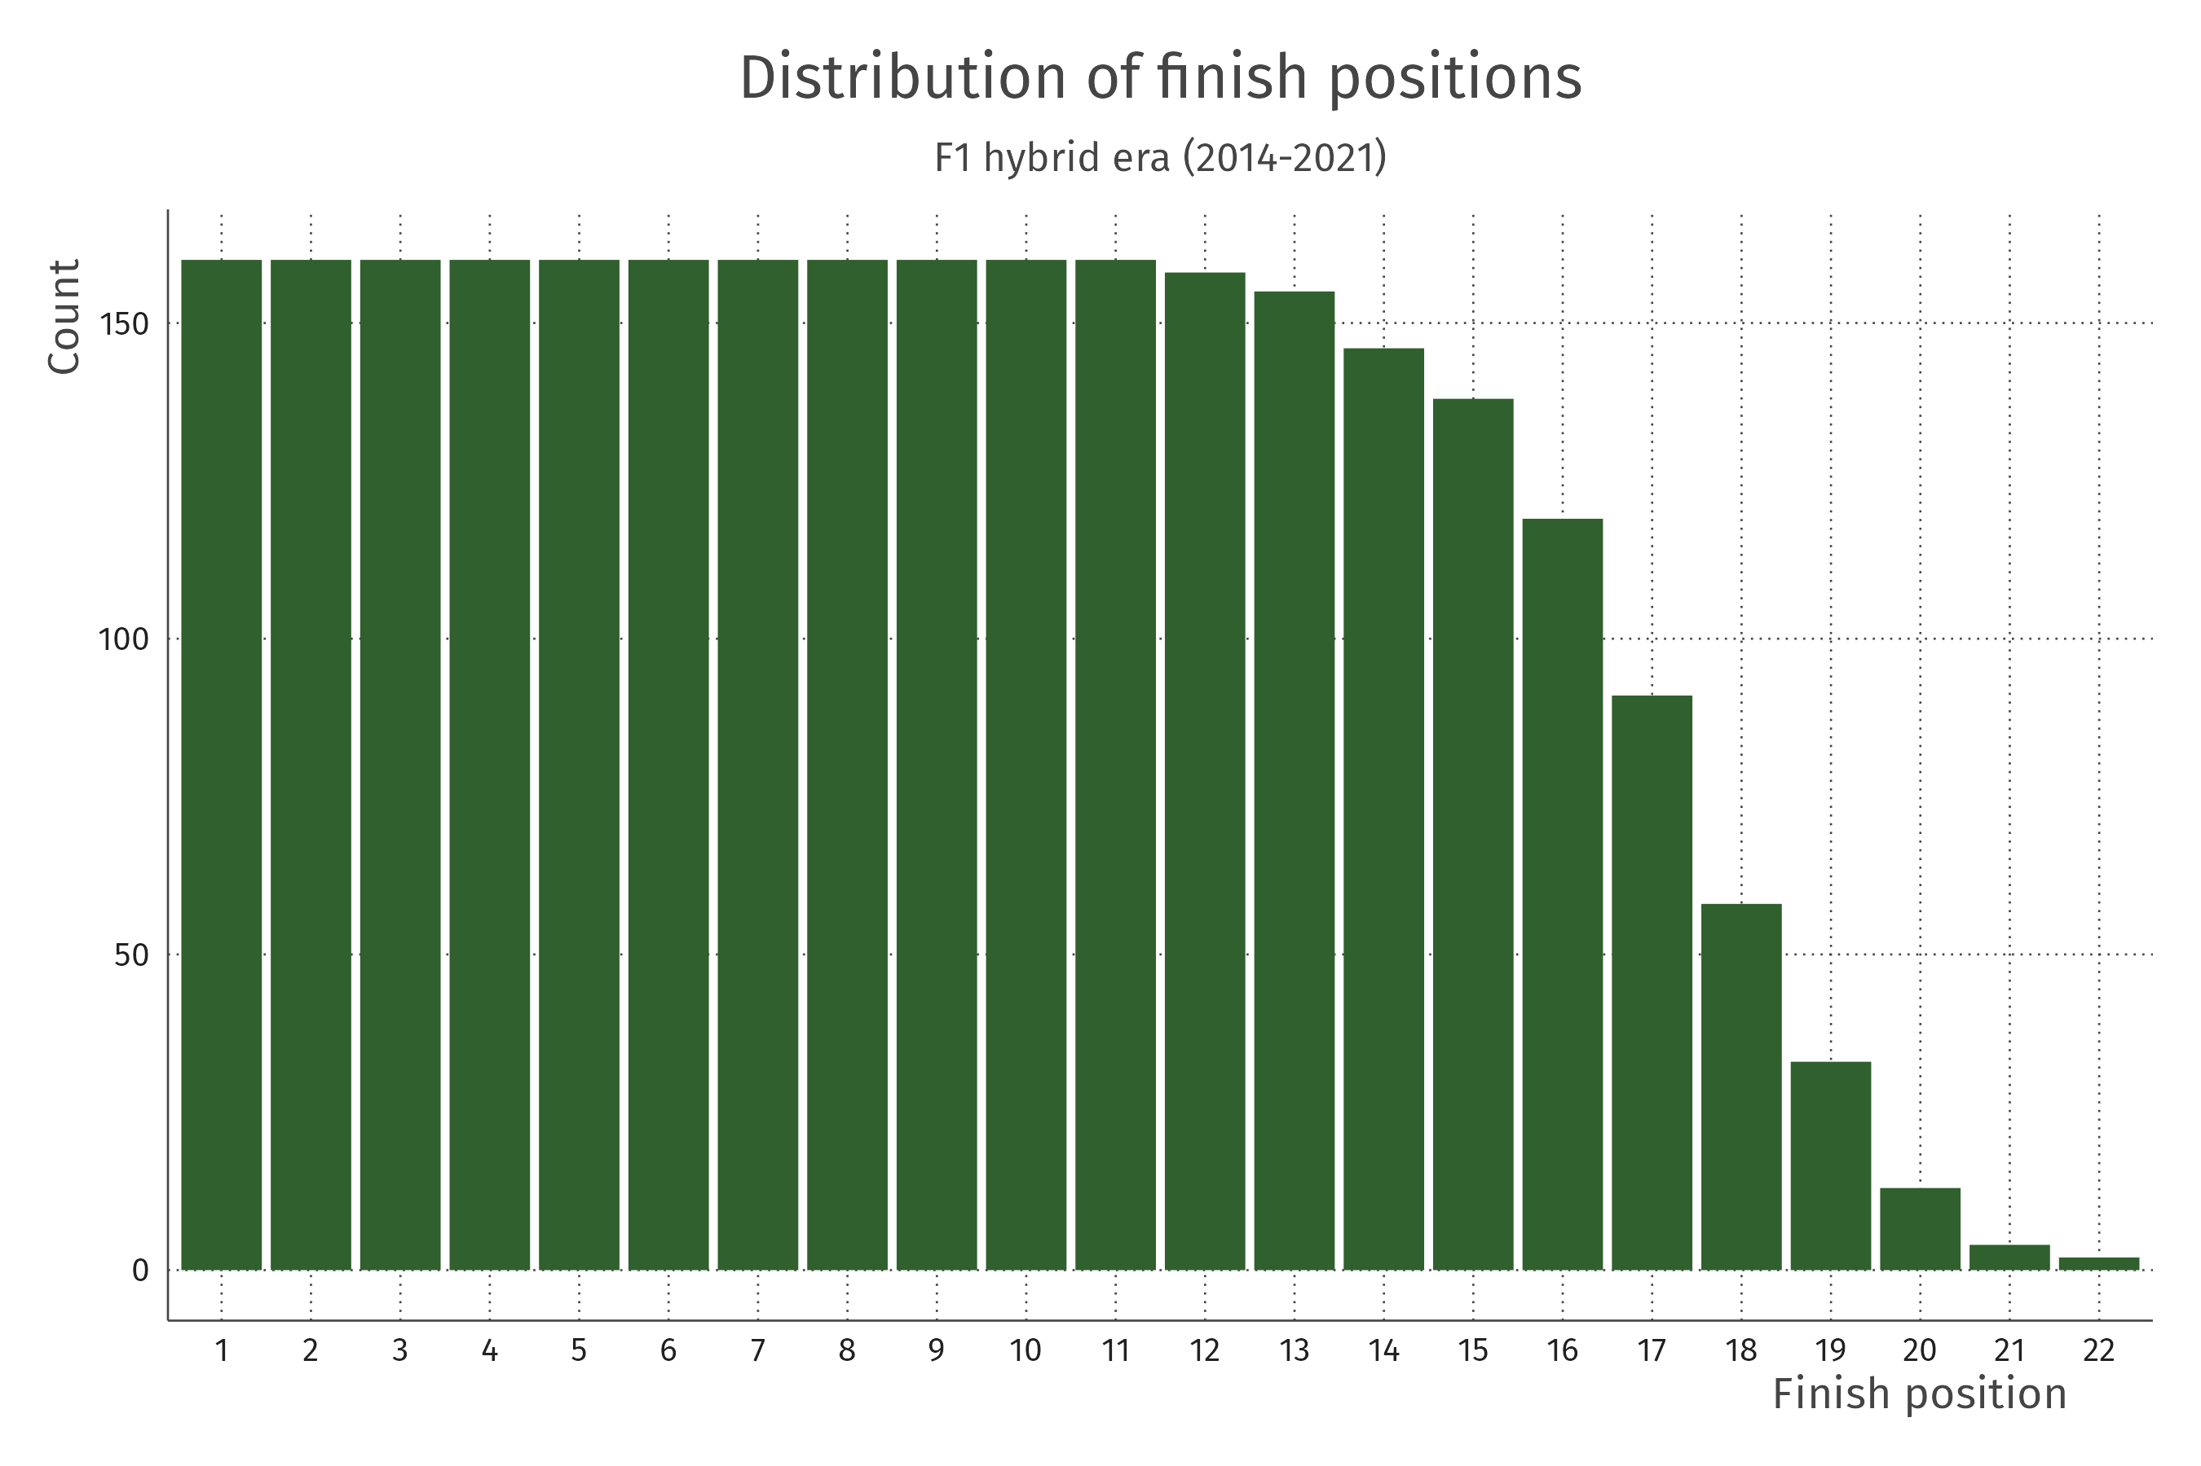
Dealing with non-finishes
Many incidents in F1
Drivers make mistakes
Constructors forget screws
Random stuff happens
The world is complicated
We don’t have a way to attribute not-finishing to drivers or constructors or randomness!
SIMPLIFYING ASSUMPTION
Look only at finished races

Slide 17
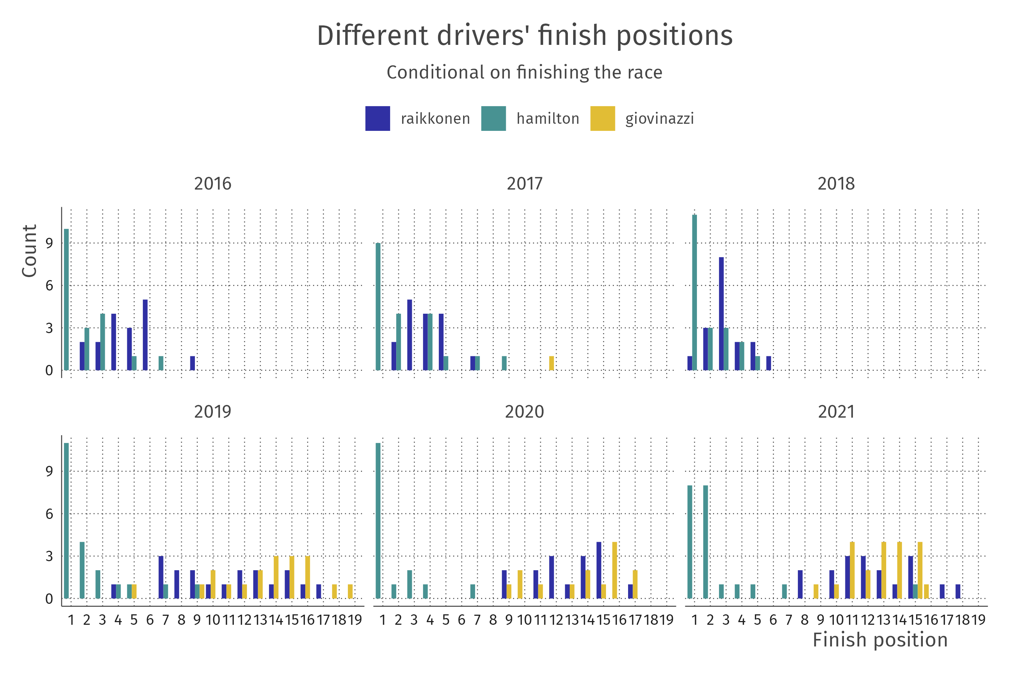

Slide 18
Which is a better performance?

Slide 19
Which is a better performance?
A
Finishing 14th in a race where 20 people finish

Slide 20
Which is a better performance?
A
B
Finishing 14th in a race where 20 people finish
Finishing 14th in a race where 14 people finish

Slide 21
Solution: the proportion
We measure performance as the proportion of drivers beaten
For each driver for each race, the proportion of drivers who finished behind the driver’s position
Empirical probability (estimate) of beating other drivers
Smooth this estimate using recommended procedure from the R package betareg

Slide 22
Solution: the proportion
library(tidyverse)
f1_dat %>%
group_by(year, round) %>%
mutate(
position_prop = (n() - position) / (n() - 1),
prop_trans = (position_prop * (n() - 1) + 0.5) / n()
)

Slide 23
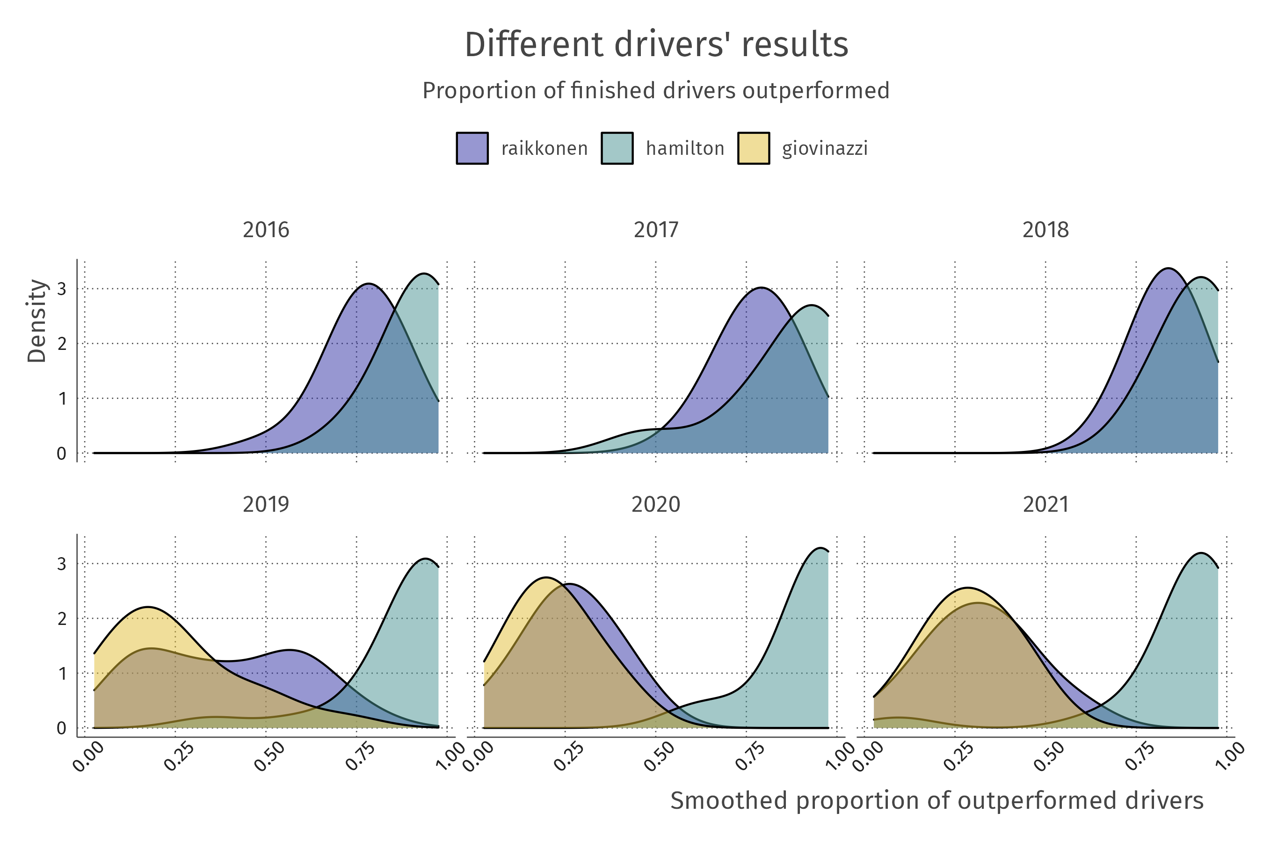

Slide 24
Modeling performance

Slide 25
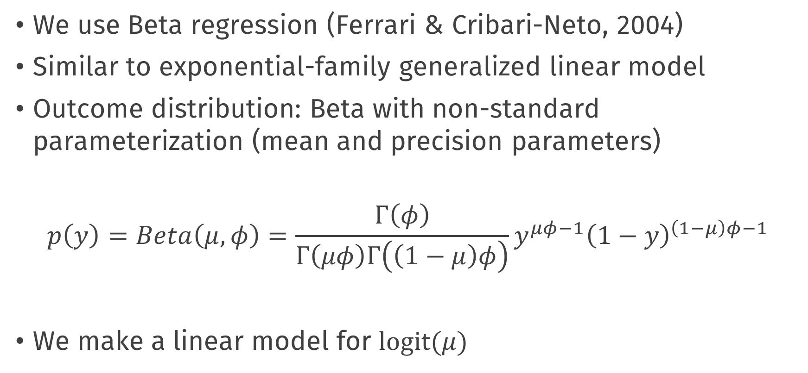
Model for a proportion
We use Beta regression (Ferrari & Cribari-Neto, 2004)
Similar to exponential-family generalized linear model
Outcome distribution: Beta with non-standard parameterization (mean and precision parameters)
$$p\left(y\right)=Beta\left(μ, φ\right)=\frac{Γ\left(φ\right)}{Γ\left(μφ\right)Γ\left(\left(1−μ\right)φ\right)}y^{μφ−1}{\left(1−y\right)}^{\left(1−μ\right)φ−1}$$
We make a linear model for $logit(μ)$

Slide 26
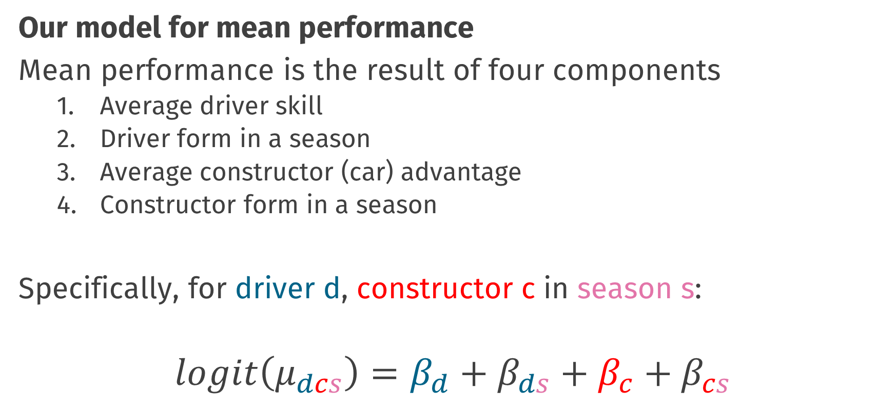
Model for a proportion
Our model for mean performance
Mean performance is the result of four components
Average driver skill
Driver form in a season
Average constructor (car) advantage
Constructor form in a season
Specifically, for driver d, constructor c in season s:
$$logit\left(μ_{dcs}\right)=β_{d}+β_{ds}+β_{c}+β_{cs}$$

Slide 27
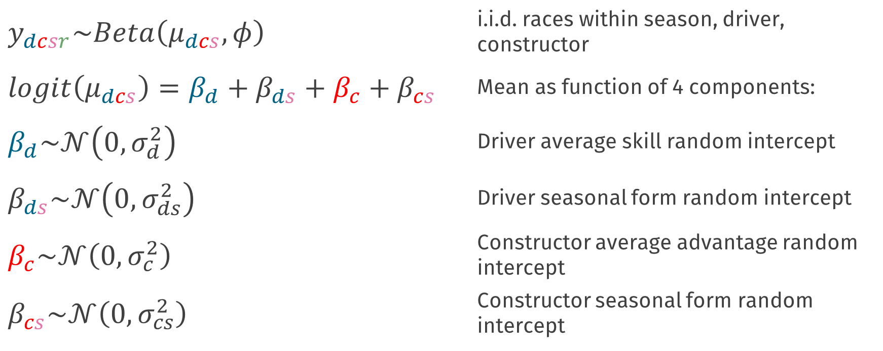
Multilevel model
49 drivers, 19 constructors, 8 seasons, 19-22 races
$$y_{dcsr}\sim Beta\left(μ_{dcs}, φ\right)$$ | i.i.d. races within season, driver, constructor
$$logit\left(μ_{dcs}\right)=β_{d}+β_{ds}+β_{c}+β_{cs}$$ | Mean as function of 4 components:
$$β_{d}\sim 𝒩\left(0,σ_{d}^{2}\right)$$ | Driver average skill random intercept
$$β_{ds}\sim 𝒩\left(0,σ_{ds}^{2}\right)$$ | Driver seasonal form random intercept
$$β_{c}\sim 𝒩\left(0,σ_{c}^{2}\right)$$ | Constructor average advantage random intercept
$$β_{cs}\sim 𝒩\left(0,σ_{cs}^{2}\right)$$ | Constructor seasonal form random intercept

Slide 28
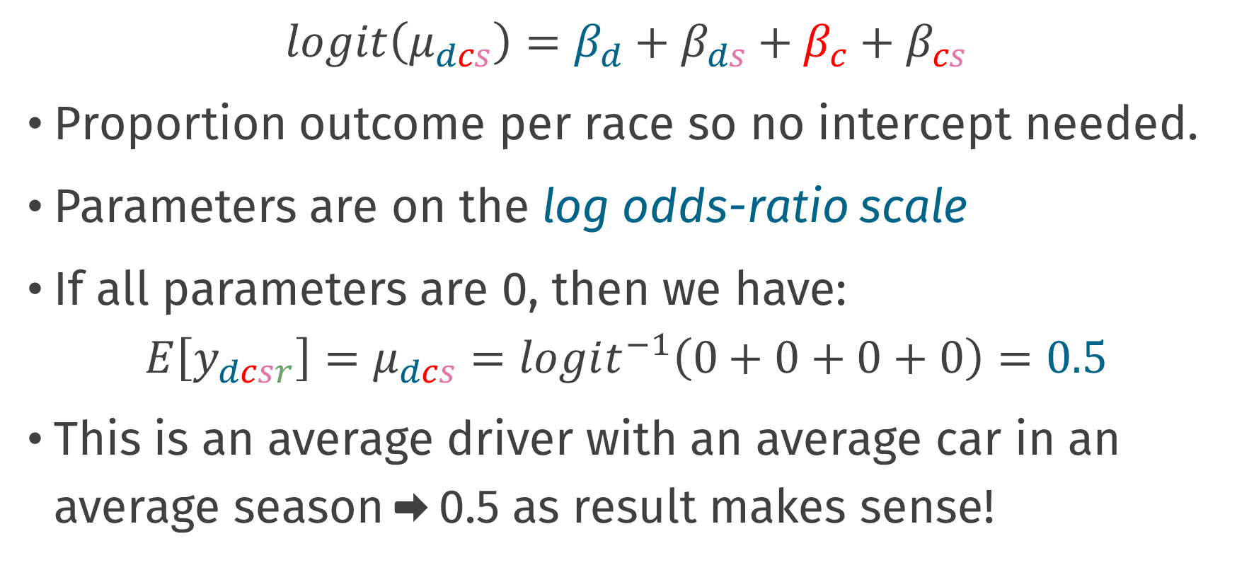
Parameter interpretation
$$logit\left(μ_{dcs}\right)=β_{d}+β_{ds}+β_{c}+β_{cs}$$
Proportion outcome per race so no intercept needed.
Parameters are on the log odds-ratio scale
If all parameters are 0, then we have:
$$E\left[y_{dcsr}\right]=μ_{dcs}=logit^{−1}\left(0+0+0+0\right)=0.5$$
This is an average driver with an average car in an average season ➡️ 0.5 as result makes sense!

Slide 29
Estimating this model

Slide 30
The data again
# A tibble: 2,677 x 5
driver constructor year round prop_trans
<fct> <fct> <int> <int> <dbl>
1 rosberg mercedes 2014 1 0.964
2 kevin_magnussen mclaren 2014 1 0.893
3 button mclaren 2014 1 0.821
4 alonso ferrari 2014 1 0.75
5 bottas williams 2014 1 0.679
6 hulkenberg force_india 2014 1 0.607
7 raikkonen ferrari 2014 1 0.536
8 vergne toro_rosso 2014 1 0.464
9 kvyat toro_rosso 2014 1 0.393
10 perez force_india 2014 1 0.321
# ... with 2,667 more rows

Slide 31
Model estimation
library(brms)
frm <-
prop_trans ~ 0 + (1 | driver) + (1 | driver:year) +
(1 | constructor) + (1 | constructor:year)
fit <- brm(
formula = frm,
family = Beta(),
data = f1_dat
)

Slide 32
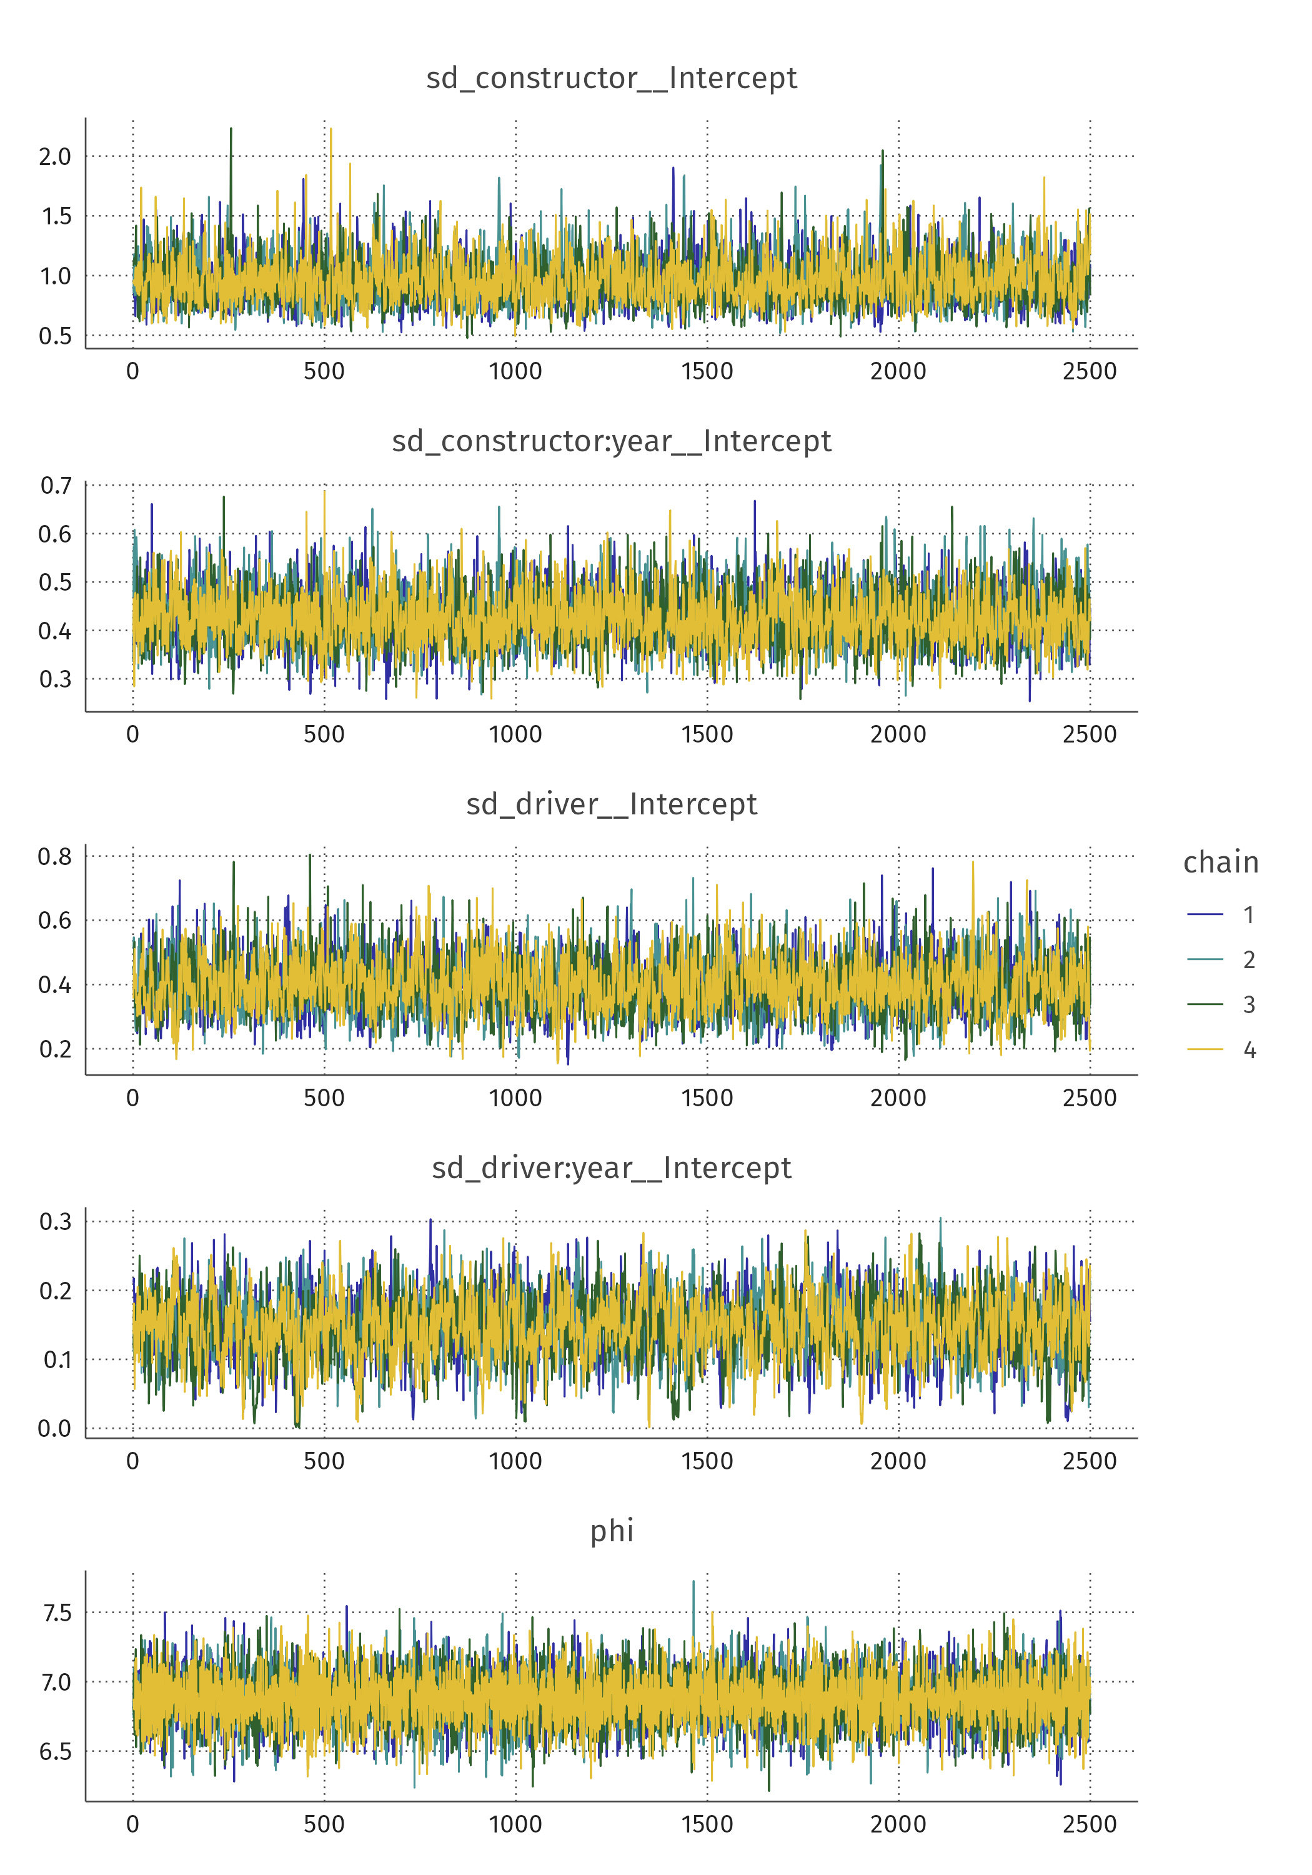
Obligatory convergence check
Everything looks good!
Rhats all <1.01
Etc.

Slide 33
Posterior predictive check
Does the model make sense?
Compare observed proportion to model-implied proportion

Slide 34
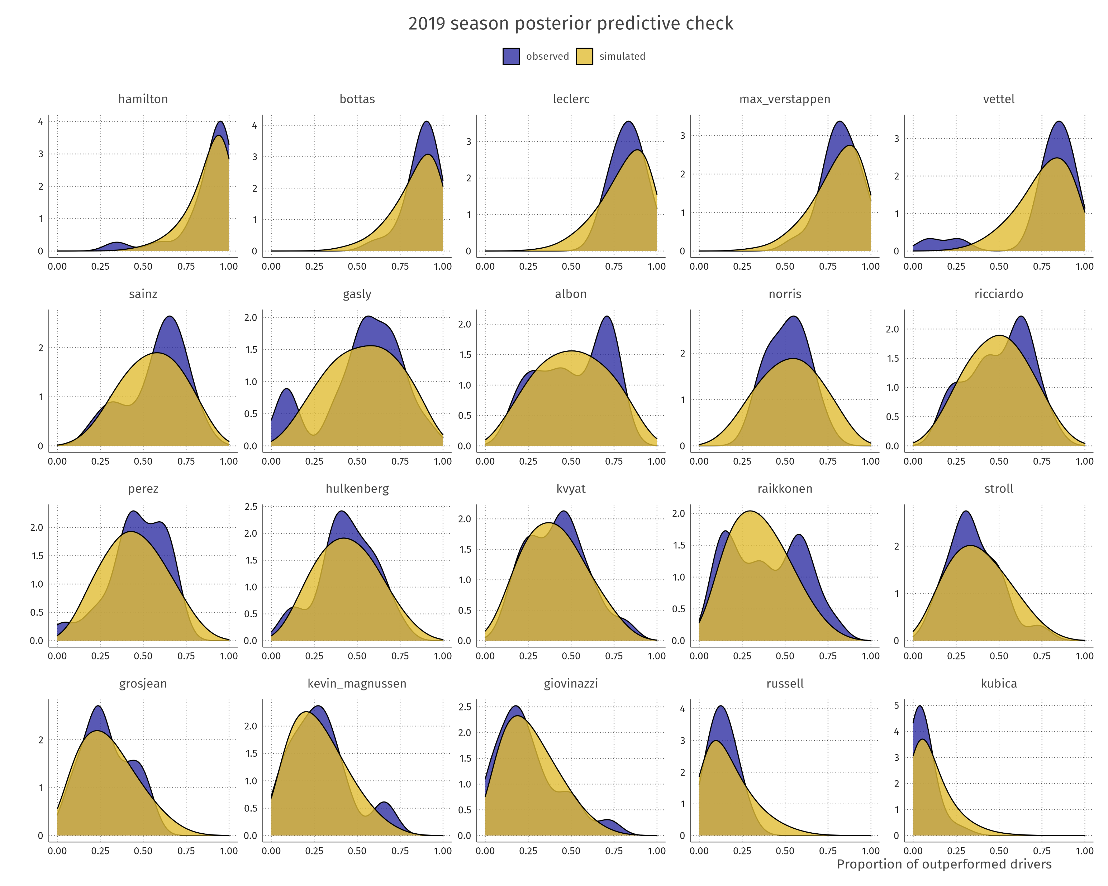

Slide 35
Inference & conclusions

Slide 36

Let’s get mystical
Photo by Viva Luna Studios on Unsplash
Notes:
https://unsplash.com/photos/mnf5Q9nTkhs

Slide 37
Dear oracle model,
How skilled was each driver in 2021?

Slide 38
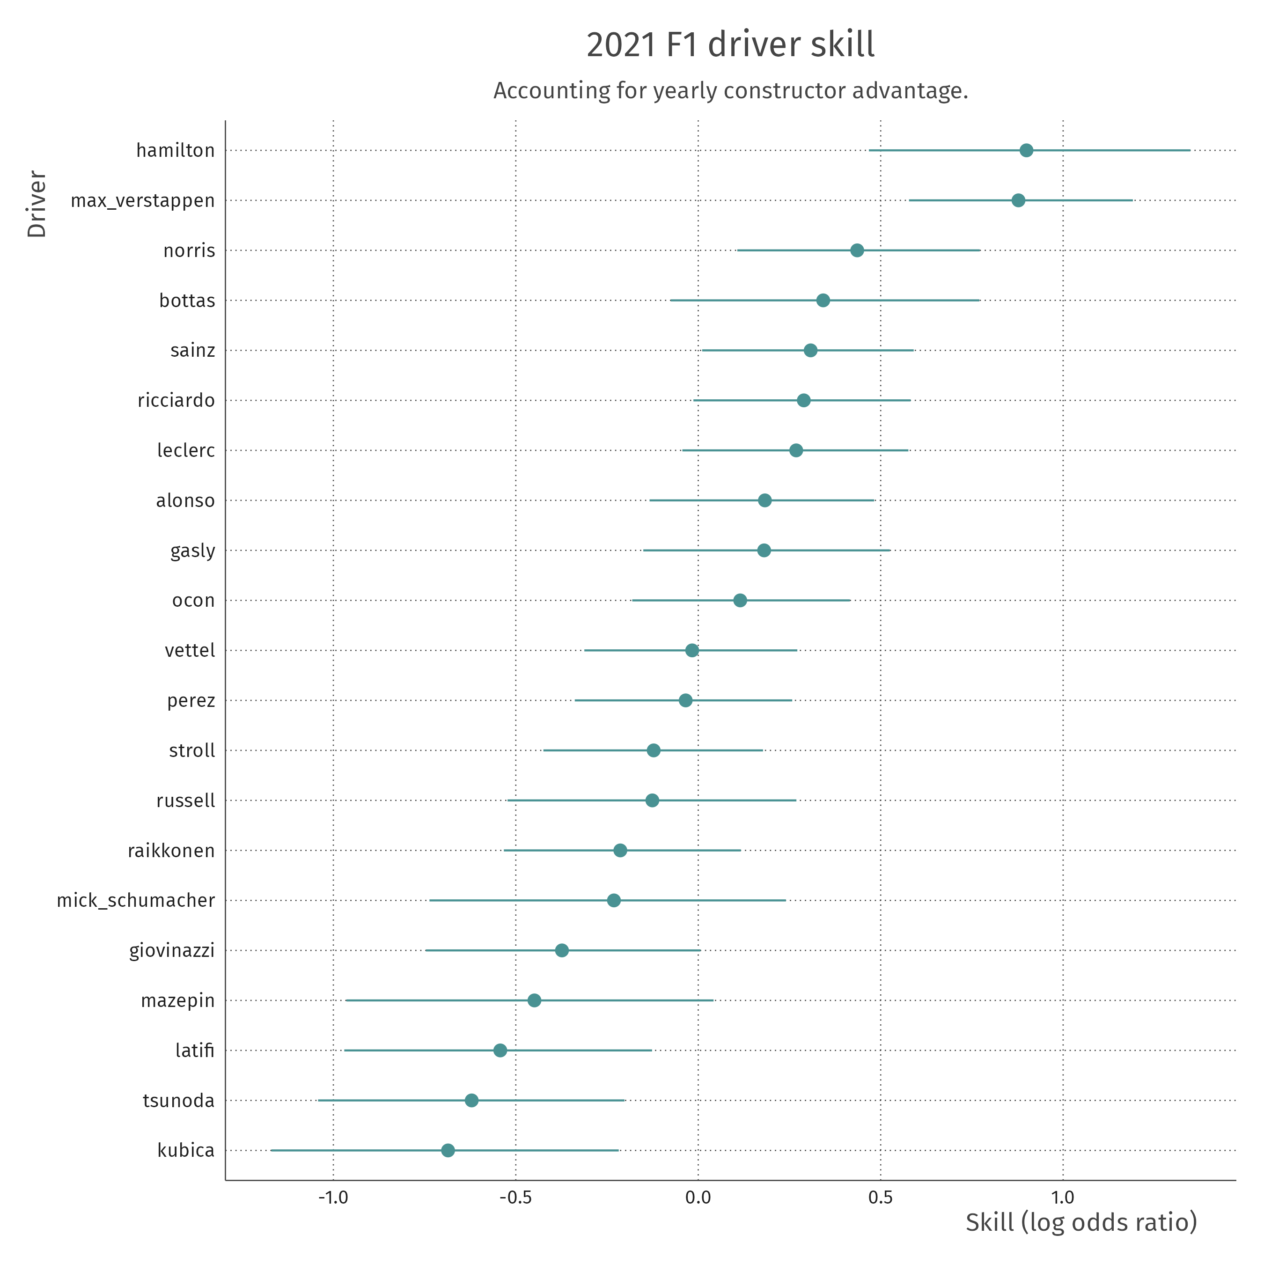
Notes:
89% pdi
38

Slide 39
According to the model:
Hiring Hamilton as opposed to an average driver yields an odds-ratio of defeating other drivers of 2.46 [1.60 – 3.86]
If your team with an average driver beats 50% of the competitors on average, then with Hamilton you will beat 71%
2.46 / (1 + 2.46) = 0.71 [0.61 – 0.79]

Slide 40
Dear oracle model,
How did the constructors compare in the hybrid era?

Slide 41
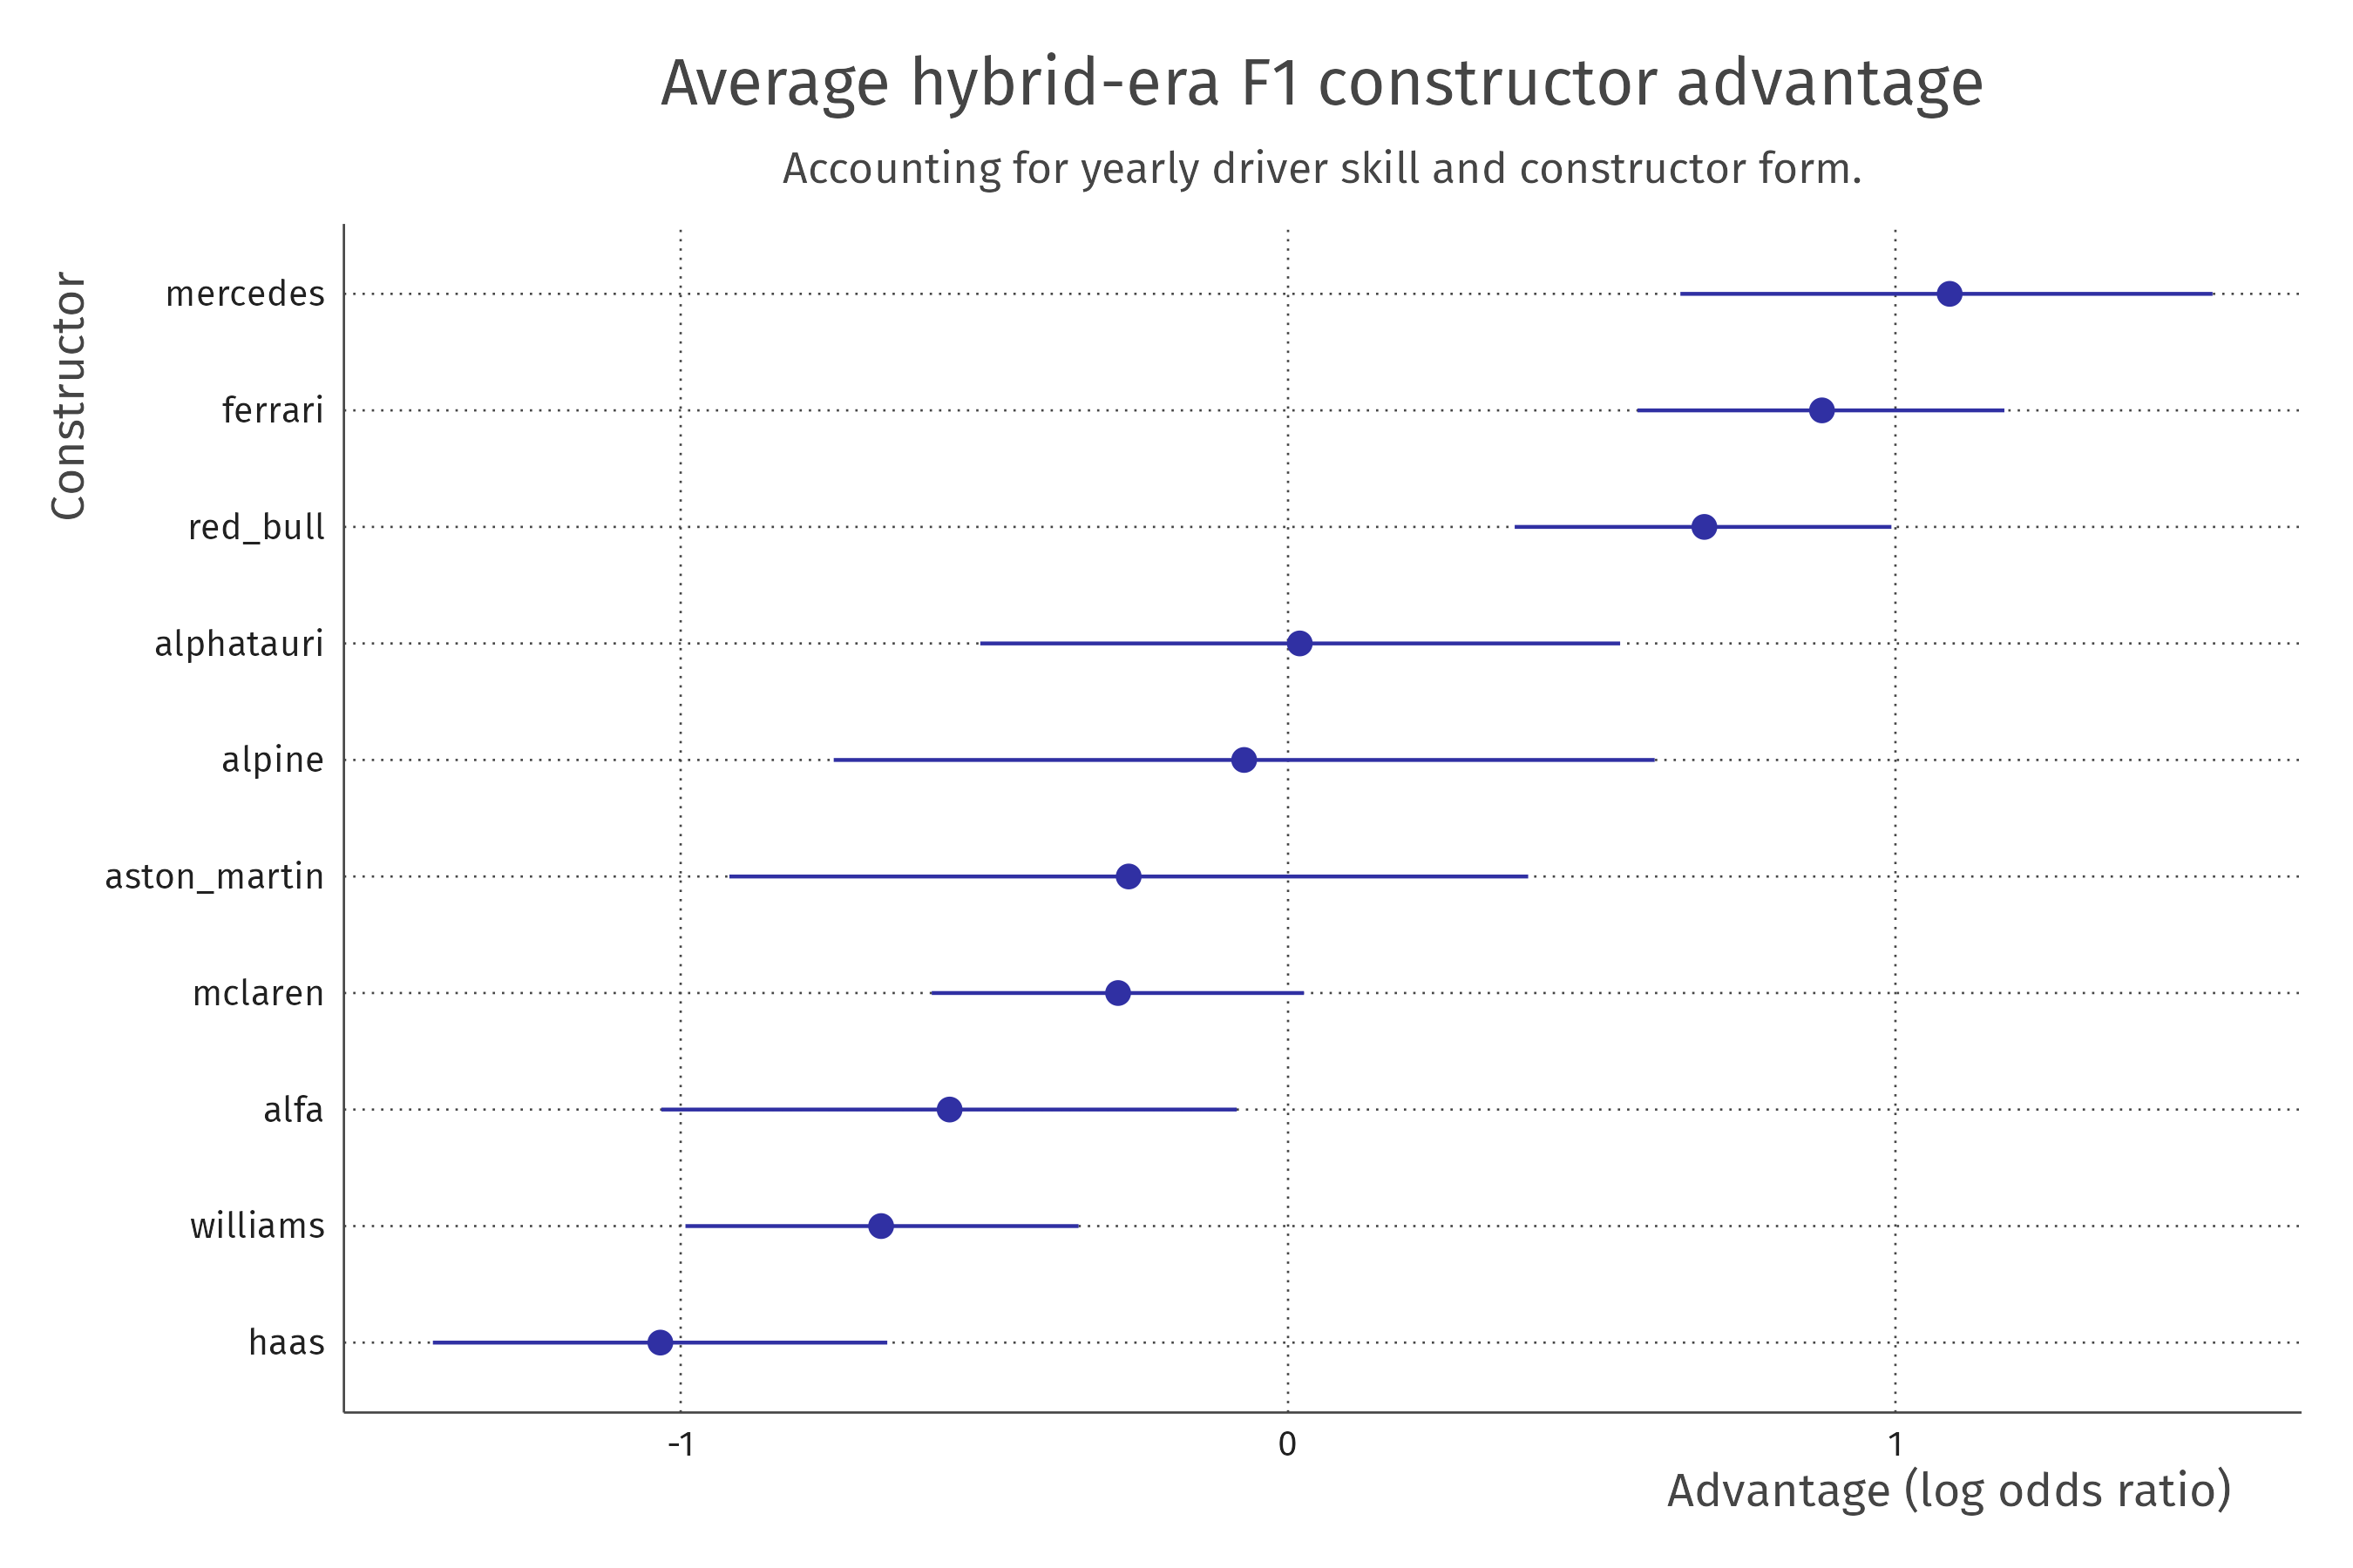
Notes:
89% pdi
41

Slide 42
According to the model:
If you are an average driver at an average team, moving to hybrid-era Mercedes yields an average odds-ratio of 2.97 [1.91 – 4.58]
If you placed middle-of-the road before, you will now on average beat three quarters of the field!
2.97 / (1 + 2.97) = 0.75 [0.66 – 0.82]

Slide 43
Dear oracle model,
How did this change over time?

Slide 44
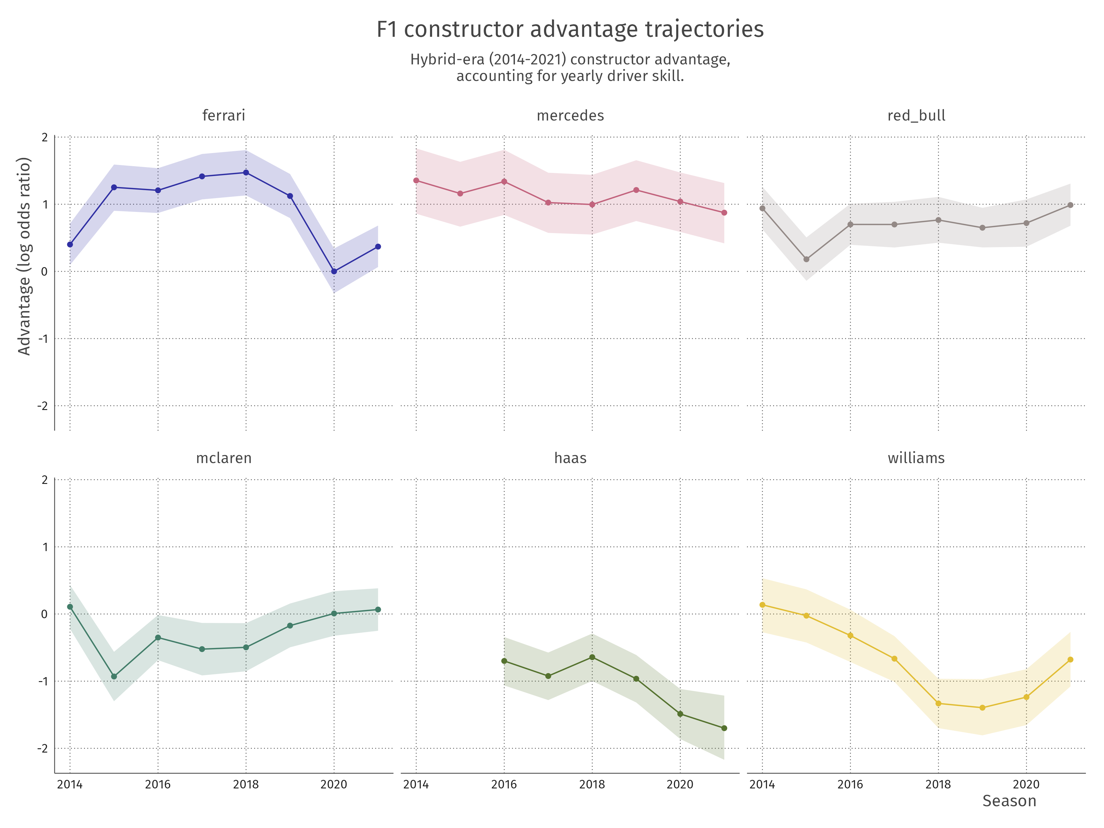
Notes:
89% pdi
44

Slide 45
???
Notes:
89% pdi
45

Slide 46
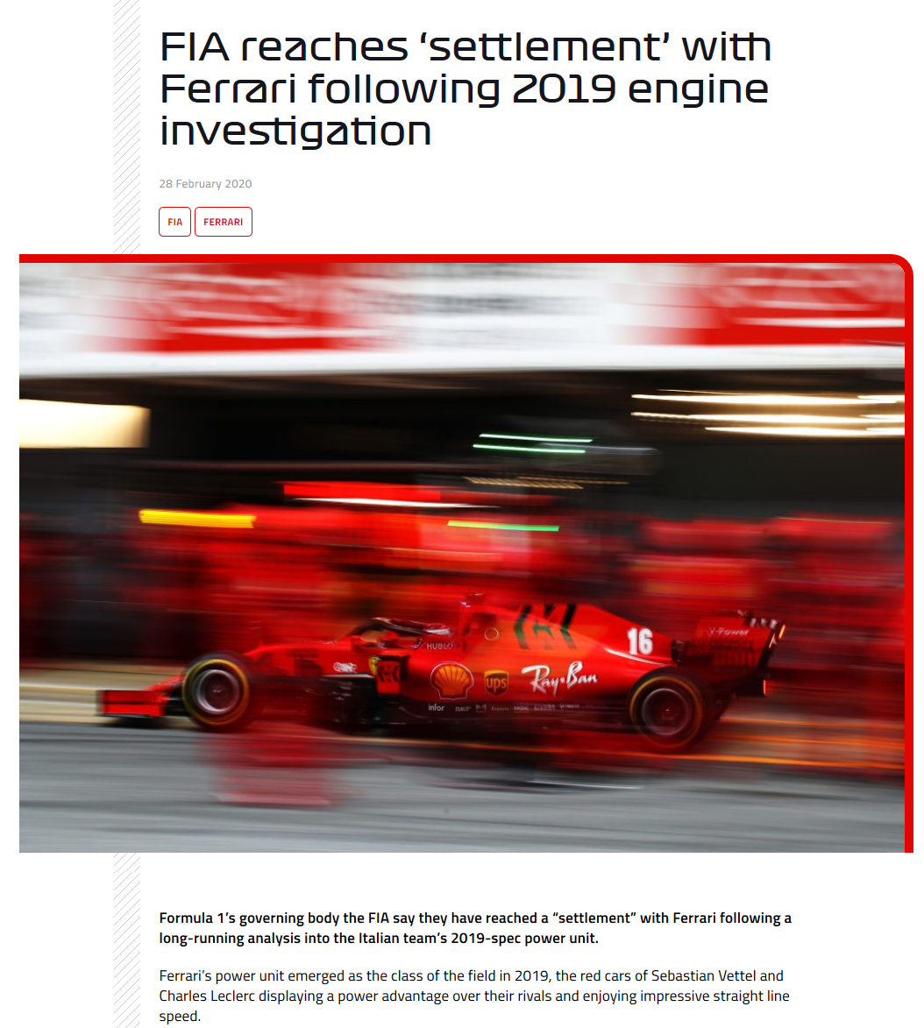
Notes:
Formula1.com
46

Slide 47
Dear oracle model,
Is it weird to like Formula One?
Is Formula One a stupid sport?

Slide 48
Dear oracle model,
Is Formula One all about the car?

Slide 49
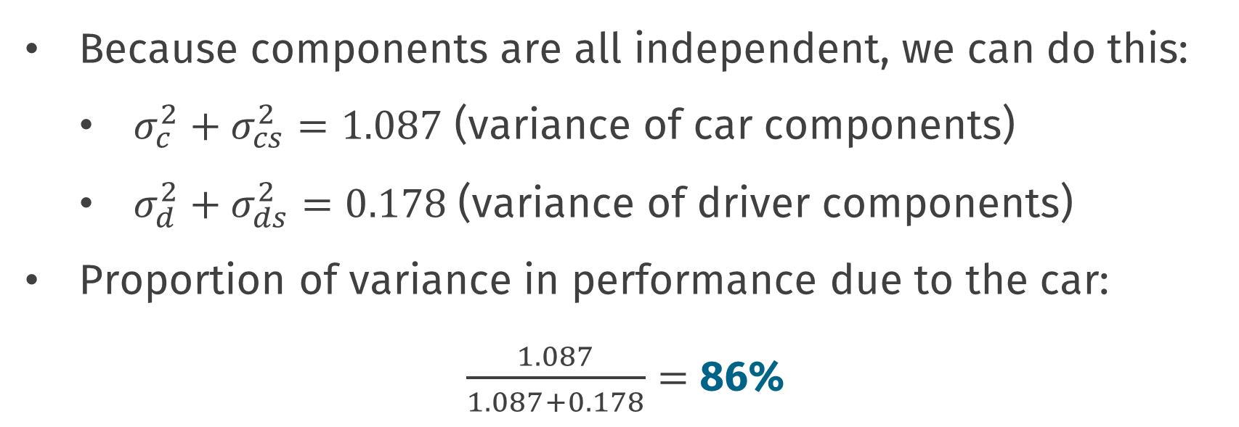
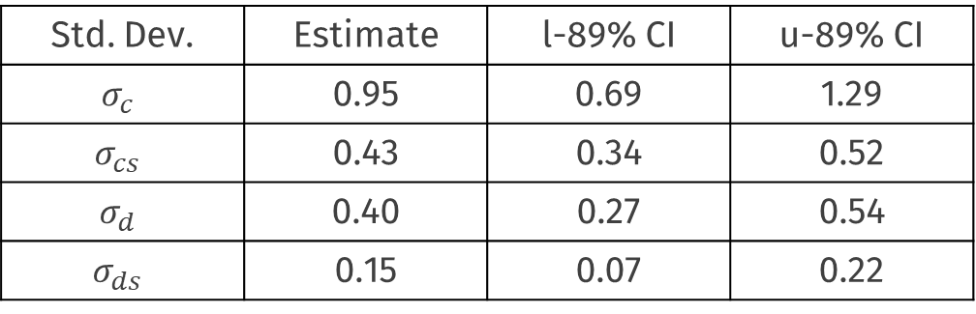
Car & driver contributions
Std. Dev. | Estimate | l-89% CI | u-89% CI
$$σ_{c}$$ | 0.95 | 0.69 | 1.29
$$σ_{cs}$$ | 0.43 | 0.34 | 0.52
$$σ_{d}$$ | 0.40 | 0.27 | 0.54
$$σ_{ds}$$ | 0.15 | 0.07 | 0.22
Because components are all independent, we can do this:
$σ_{c}^{2}+σ_{cs}^{2}=1.087$ (variance of car components)
$σ_{d}^{2}+σ_{ds}^{2}=0.178$ (variance of driver components)
Proportion of variance in performance due to the car:
$\frac{1.087}{1.087+0.178}=$ 86%

Slide 50
It’s not all about the car

Slide 51
Almost though… ☺

Slide 52
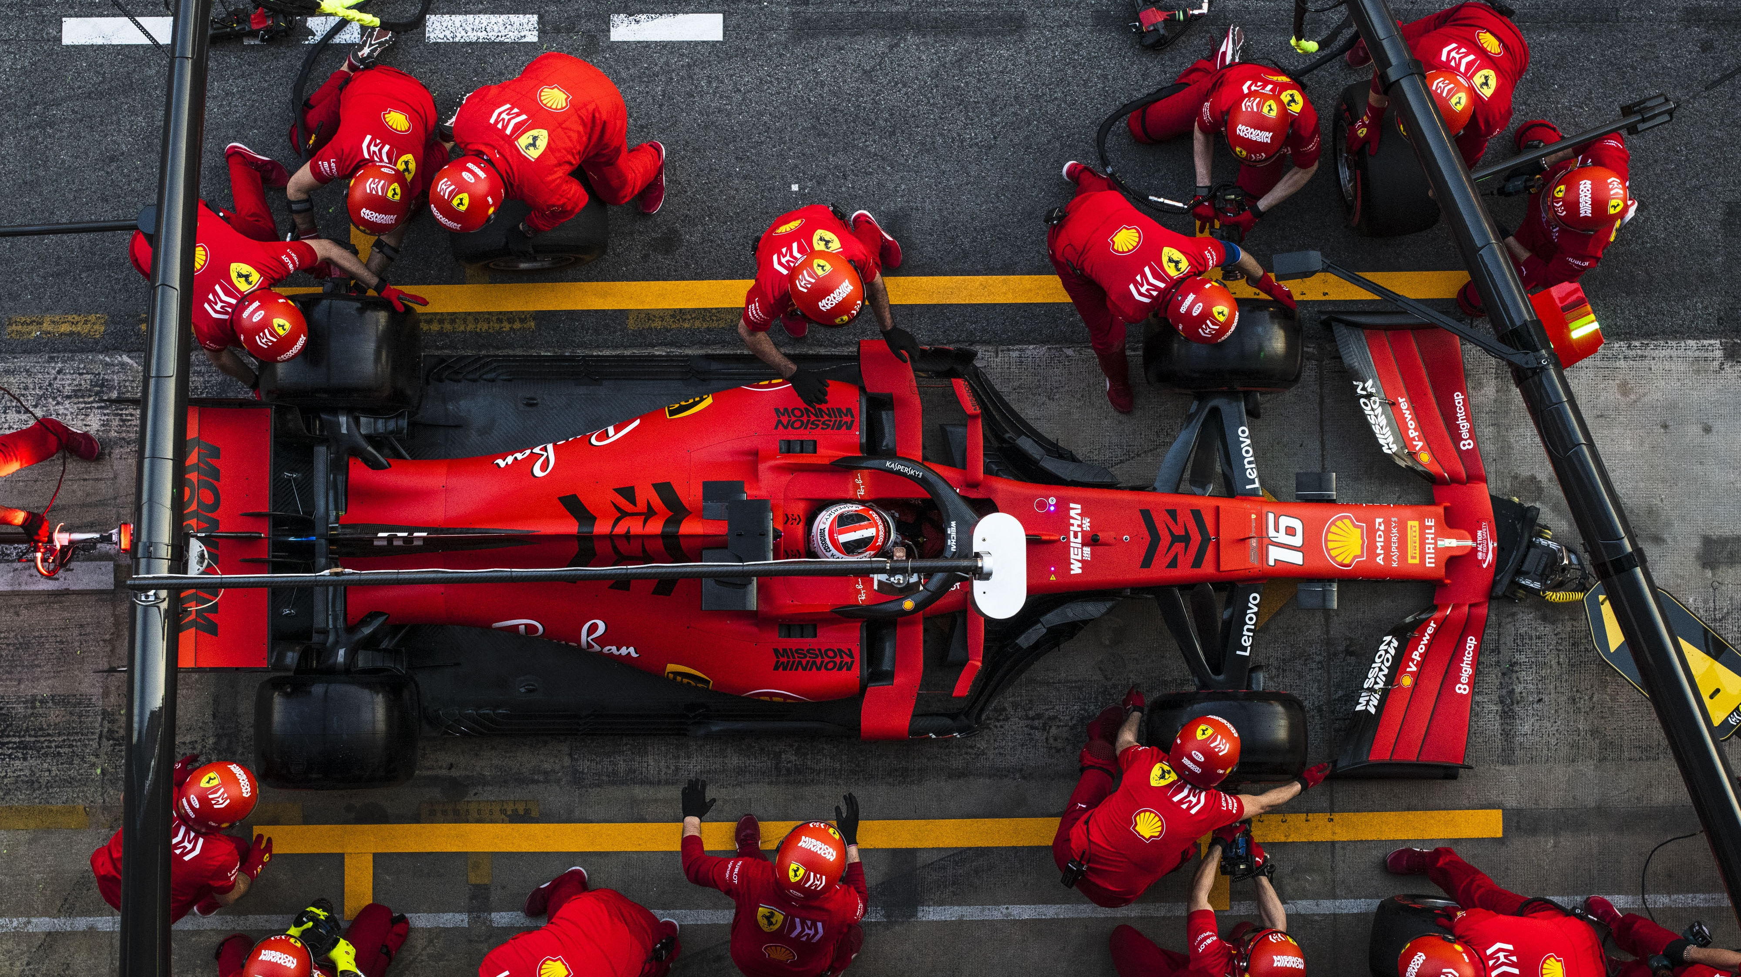
Photo by gustavo Campos on Unsplash
Notes:
https://unsplash.com/photos/B87zMorEZRo

Slide 53
Questions?

Slide 54
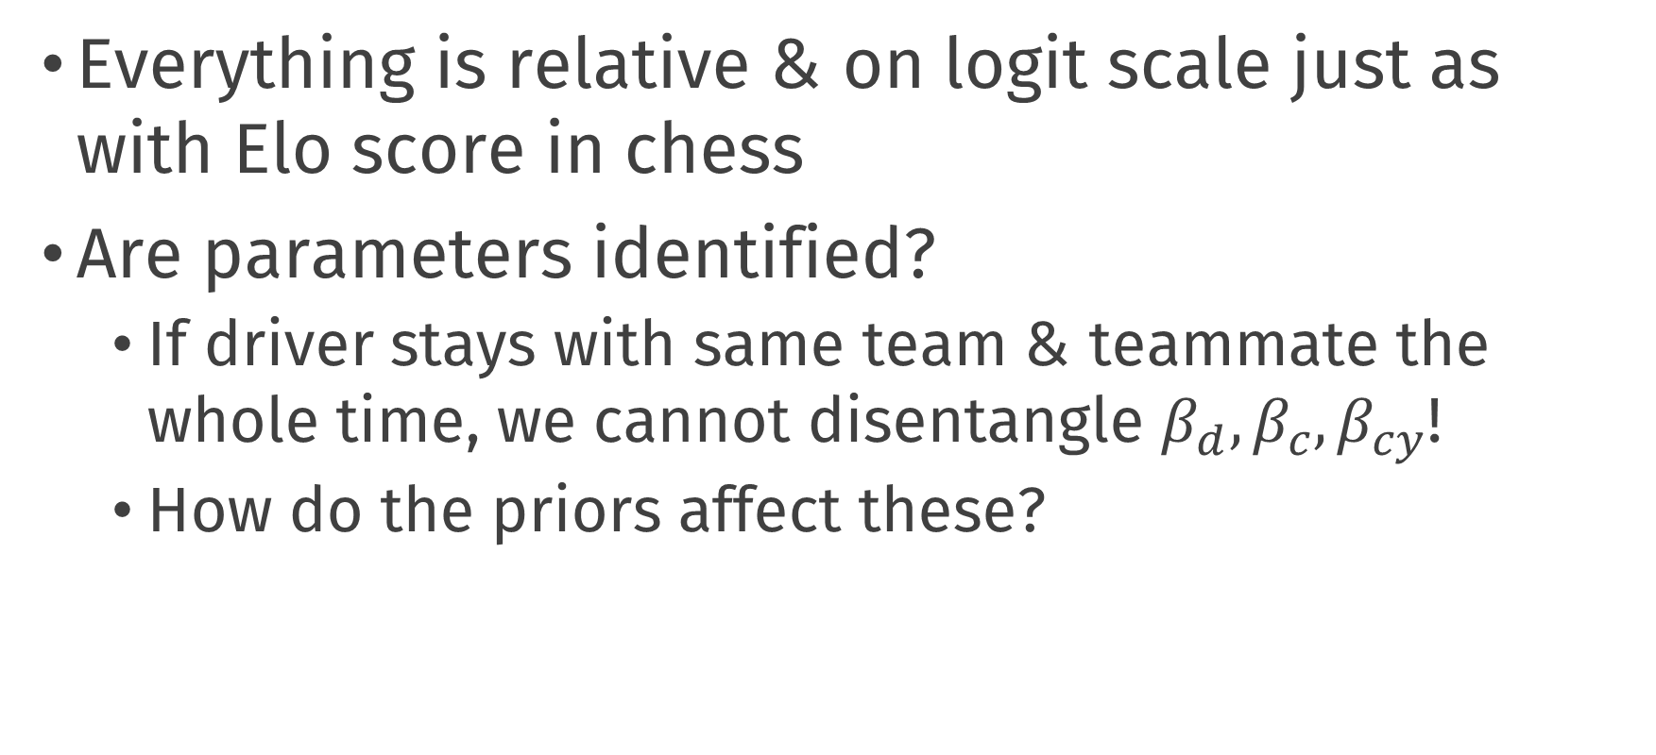
Thoughts & issues
Everything is relative & on logit scale just as with Elo score in chess
Are parameters identified?
If driver stays with same team & teammate the whole time, we cannot disentangle $β_{d}, β_{c},β_{cy}$!
How do the priors affect these?

Slide 55
Default dark slide
Default subheading
The dark slide brings some variation
Default subheading
It can highlight important aspects of the presentation.
Default subheading
This is the body of the text
Default subheading
This is the body of the text

Slide 56
Is this an impact slide?

Slide 57
Here is an impactful slide with a sentence on it.
Here is a topic related to the aforementioned question.

Slide 58

Thank you!

